Slide 1


Detecting Fake News with Machine Learning
In an era of rapid information dissemination, the spread of misinformation, often termed "fake news," poses a significant challenge. This presentation outlines a project designed to automatically detect fake news using machine learning, providing a robust solution with a user-friendly interface and a persistent database backend.
Notes:
1

Slide 2




Project Overview
Combat Misinformation
Machine Learning Core
Automatically detect fake news to help users identify unreliable content.
Utilize a robust ML model for accurate classification.
Intuitive User Interface
Reliable Data Storage
Provide an accessible web interface for seamless interaction.
Integrate a database for logging predictions and user inputs.
Notes:
2

Slide 3
Core Objectives
Develop ML Classifier
1
Build a high-accuracy machine learning model specifically for fake news detection.
Implement Streamlit UI
2
Create an interactive and responsive user interface using Streamlit for easy access.
Integrate PostgreSQL
3
Seamlessly connect with PostgreSQL to store and retrieve all prediction and interaction data.
Notes:
3

Slide 4
Technology Stack
Frontend: Streamlit
Frontend
Interactive, chatbot-style web interface.
Streamlit
No need for HTML, CSS, or JavaScript.
Displays prediction results clearly and intuitively.
Backend
Backend: Machine Learning Model
ML Model (Logistic Regression)
Logistic Regression for classification.
Handles preprocessing and TF-IDF vectorization.
Database
Database: PostgreSQL
PostgreSQL
Stores user queries, predictions, confidence scores, and timestamps.
Notes:
4

Slide 5
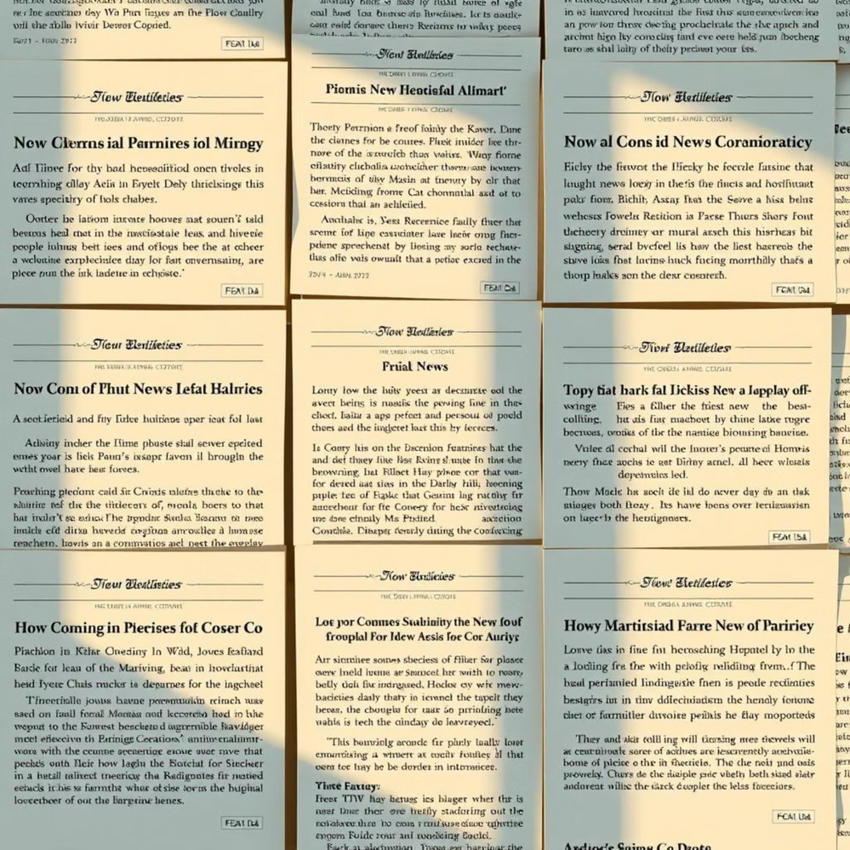
Dataset and Features
Dataset
Comprises 40,000 labeled news articles.
Includes both real and fake news examples.
Sourced from Kaggle or reputable open-source news archives.
Features
Each article features a distinct title.
Comprehensive content provides textual data for analysis.
A binary label (0 or 1) indicates authenticity (0 for real, 1 for fake).
Notes:
5

Slide 6




Data Preprocessing Pipeline
Text Cleaning
Stopword Removal
Removed punctuation, converted text to lowercase, and handled special characters.
Eliminated common words (e.g., "the," "is") that don't add significant value to analysis.
TF-IDF Vectorization
Data Splitting
Applied Term Frequency-Inverse Document Frequency to transform text into numerical vectors, emphasizing important words.
Divided the dataset into 80% for training the model and 20% for testing its performance.
Notes:
6

Slide 7
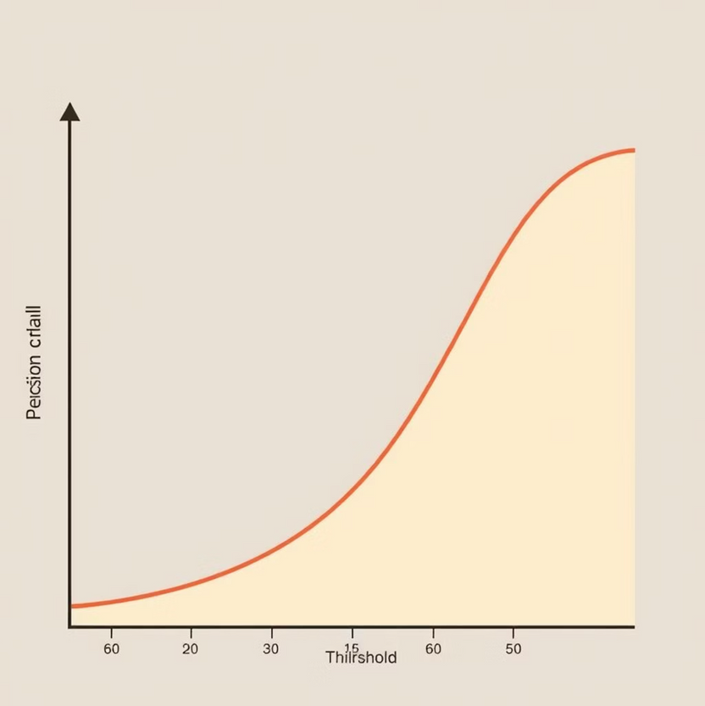
Logistic Regression Model
Algorithm Choice
Logistic Regression was selected as the primary classification algorithm for its effectiveness in binary classification tasks.
Binary Classification
Ideally suited for distinguishing between two classes: real news (0) and fake news (1).
Probability Scores
The model outputs a confidence score, indicating the likelihood of an article being fake (e.g., 73% Fake).
Notes:
7

Slide 8
PostgreSQL Integration
The PostgreSQL database serves as the persistent storage layer, capturing all interactions and predictions from the fake news detection system. This ensures data integrity and provides a historical log for analysis and auditing.
ID
Timestamp
User Message
Prediction
Confidence Score
1
2023-10-26 10:00:00
Article about alien invasion
Fake
95%
2
2023-10-26 10:05:30
Report on climate change research
Real
88%
3
2023-10-26 10:15:10
Breaking news on a new cure
Fake
73%
4
2023-10-26 10:20:45
Company Q3 earnings report
Real
92%
Notes:
8

Slide 9





Streamlit Interface
Text Input
Users can enter news content manually for analysis.
Character Limit
Input is capped at 1000 characters for focused and efficient predictions.
Export Results
Users can easily save prediction outcomes as a .txt file for record-keeping.
PostgreSQL Integration
All user queries and corresponding predictions are logged in real-time to the database.
Notes:
9

Slide 10
Conclusion and Future Enhancements
1
Successful Implementation
2
Key Integrations
3
Future Directions
Streamlit provides an intuitive user interface, while PostgreSQL ensures reliable storage and retrieval of all interaction data.
Future improvements could include exploring more advanced NLP techniques, incorporating real-time data feeds, and enhancing model accuracy through deep learning approaches.
A functional fake news detection system has been successfully built, integrating a machine learning model with a user-friendly frontend and a robust backend.
Notes:
10

